Slide 1
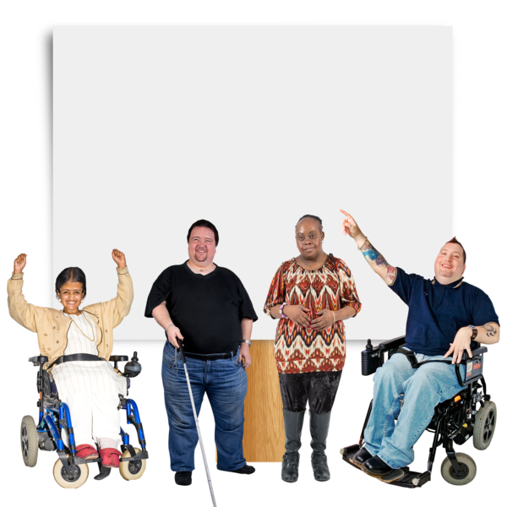
Introduction to Surrey Coalition of Disabled People (SCDP)
This document includes images licensed from Photosymbols. Thank you to Coalition member and volunteer, Carinder, for helping to create this document.

Slide 2
Overview of the charity and its mission
The Coalition is run by Disabled people
We help Disabled people in Surrey to be part of the community
We campaign for the legal rights of Disabled people. We celebrate diversity and inclusion

Slide 3
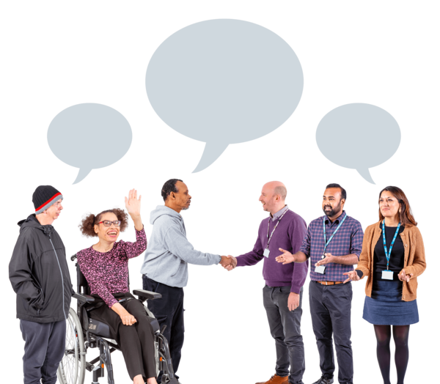
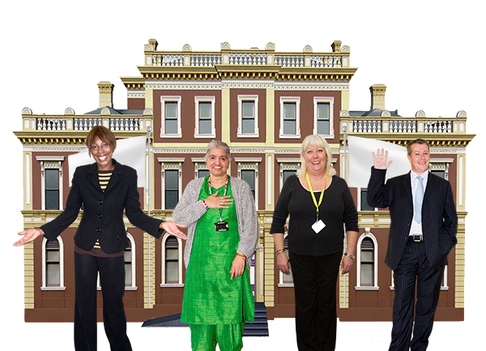
Key Initiatives and Advocacy Work
The Coalition works with community partners, local authorities and social care to create plans and improve services.

Slide 4
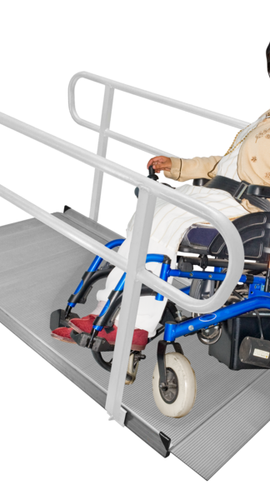
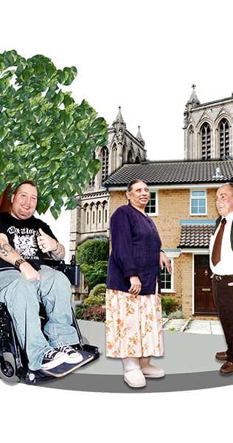
Impact on the Community
The Coalition improve accessibility and services for Disabled people
We create campaigns to help Disabled people be an active and central part of the community

Slide 5
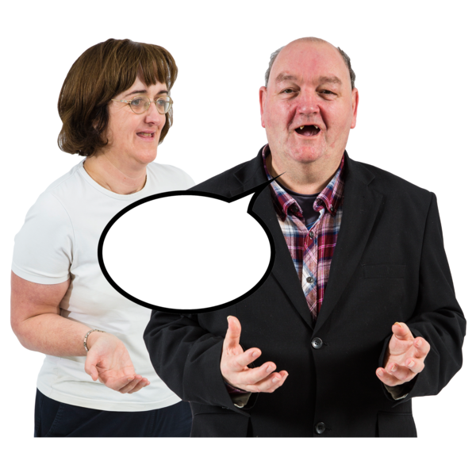
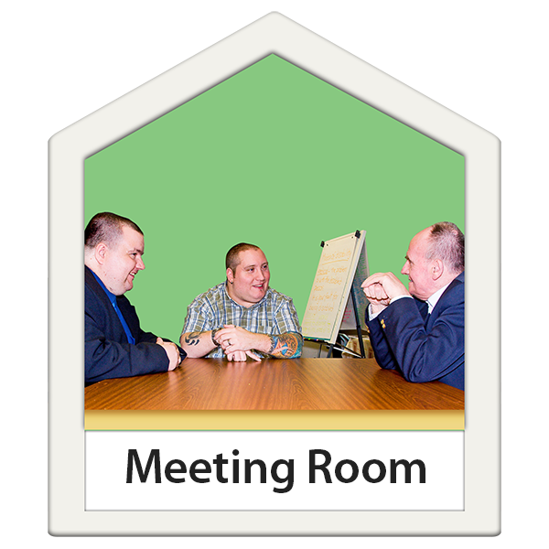
Mental health and well-being
The Independent Mental Health Network (IMHN) work with the NHS and social care service providers to improve mental health care
IMHN members tell us about their experiences with mental health service
We share this feedback with the NHS and social care service providers

Slide 6
Weekly Events and Social Activities
The Coalition host virtual social activities for Coalition Members.
Virtual Café: A community catch-up every Monday and Friday
Glee Club: Music-themed sessions every Tuesday
Quiz Thursdays: Fun, interactive general knowledge quizzes

Slide 7
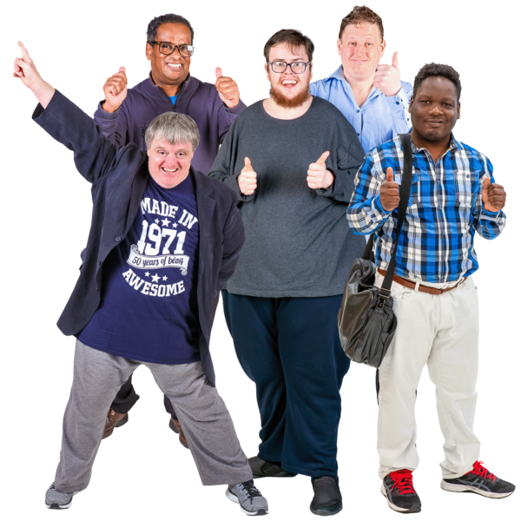
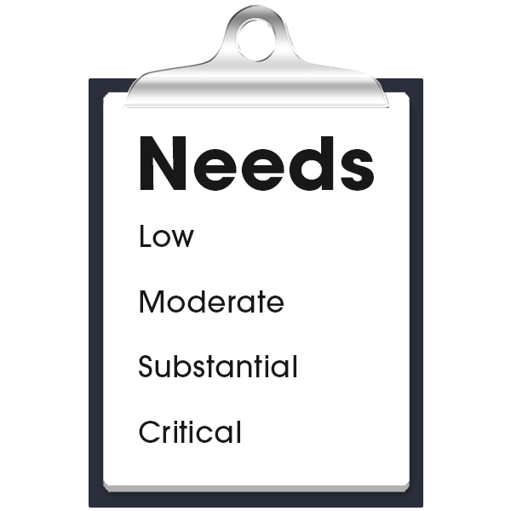
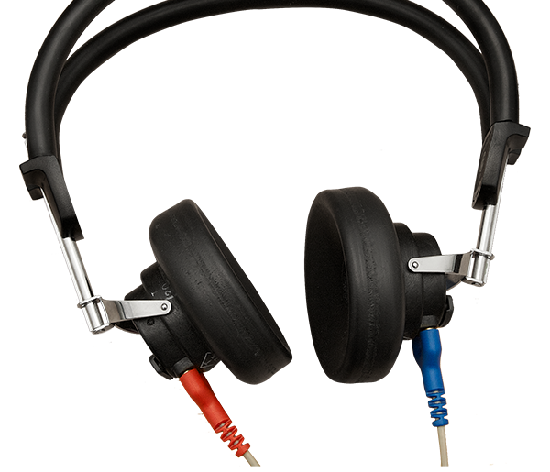
Campaigns and Advocacy Groups
Independent Mental Health Network (IMHN): Supporting mental health advocacy and resources
Hard of Hearing Forum: active campaigners for SMS text numbers
Surrey Vision Action Group: Dedicated to improving services for the visually impaired

Slide 8
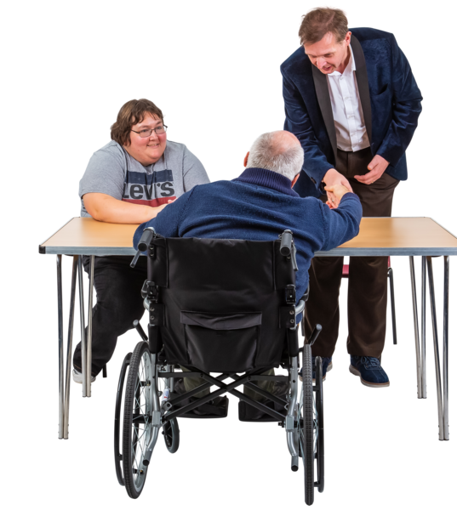
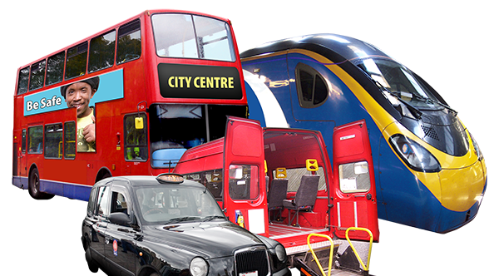
Campaigns and Advocacy Groups
Community Equipment Group: Advocacy for improved access to mobility aids and assistive technology
Let’s Hear Surrey: Supporting those with hearing impairments
Campaigns Committee: Leading change for disability rights in Surrey
Long Term Neurological Conditions: providing feedback on experiences of neurological services.

Slide 9
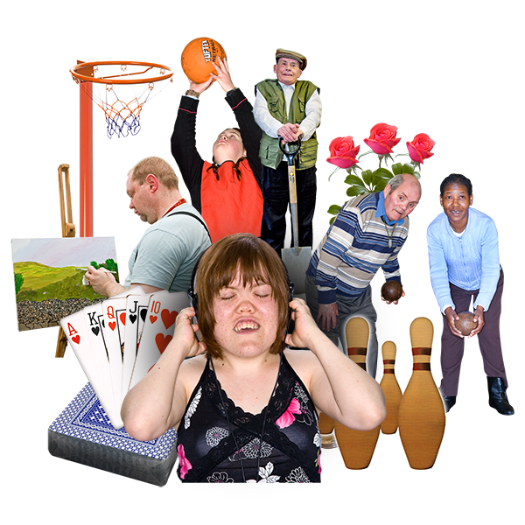
Physical Activity
Access to advice and support to help you get active
Get More Active social events - members meet for accessible sport activities

Slide 10
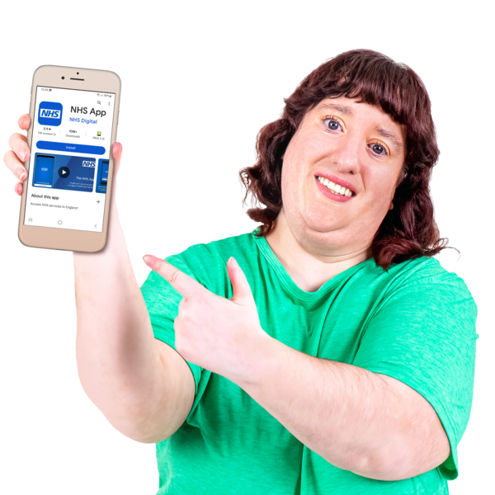
Digital Support
Tech Angel Program: Assistance with technology for those who need help accessing digital tools

